Slide 1
Stack

Slide 2
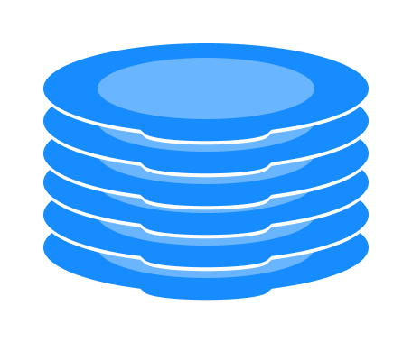

Slide 3
Stack
A stack is a list of elements in which an element may be inserted or deleted only at one end, called the top of the stack.
This means, in particular, that elements are removed from a stack in the reverse order of that in which they were inserted into the stack.

Slide 4
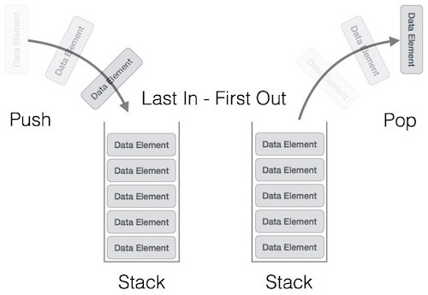

Slide 5
Special terminology is used for two basic operations associated with stacks:
(a) “Push” is the term used to insert an element into a stack.
(b) “Pop” is the term used to delete an element from a stack.

Slide 6
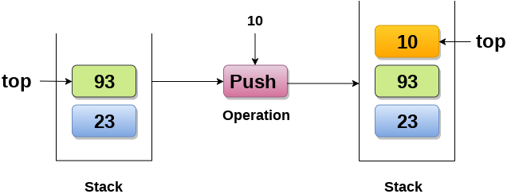

Slide 7
Push operation
Step 1 − Checks if the stack is full.
Step 2 − If the stack is full, produces an error and exit.
Step 3 − If the stack is not full, increments top to point next empty space.
Step 4 − Adds data element to the stack location, where top is pointing.
Step 5 − Returns success.

Slide 8
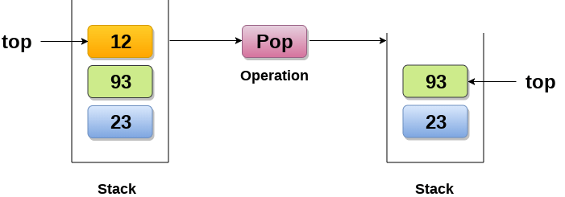

Slide 9
A Pop operation may involve the following steps −
Step 1 − Checks if the stack is empty.
Step 2 − If the stack is empty, produces an error and exit.
Step 3 − If the stack is not empty, accesses the data element at which top is pointing.
Step 4 − Decreases the value of top by 1.
Step 5 − Returns success.

Slide 10
Notation
The way to write arithmetic expression is known as a notation. An arithmetic expression can be written in three different but equivalent notations. These notations are −
Infix Notation
Prefix (Polish) Notation
Postfix (Reverse-Polish) Notation
These notations are named as how they use operator in expression.

Slide 11
Infix Notation
Infix Notation
We write expression in infix notation, e.g. a - b + c, where operators are used in-between operands.
It is easy for us humans to read, write, and speak in infix notation but the same does not go well with computing devices.
An algorithm to process infix notation could be difficult and costly in terms of time and space consumption.

Slide 12
Prefix Notation
Prefix Notation
In this notation, operator is prefixed to operands, i.e. operator is written ahead of operands. For example, +ab.
This is equivalent to its infix notation a + b.
Prefix notation is also known as Polish Notation.

Slide 13
Postfix Notation
Postfix Notation
This notation style is known as Reversed Polish Notation.
In this notation style, the operator is postfixed to the operands i.e., the operator is written after the operands.
For example, ab+. This is equivalent to its infix notation a + b.

Slide 14
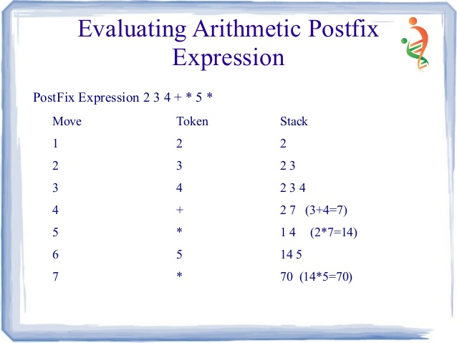

Slide 15
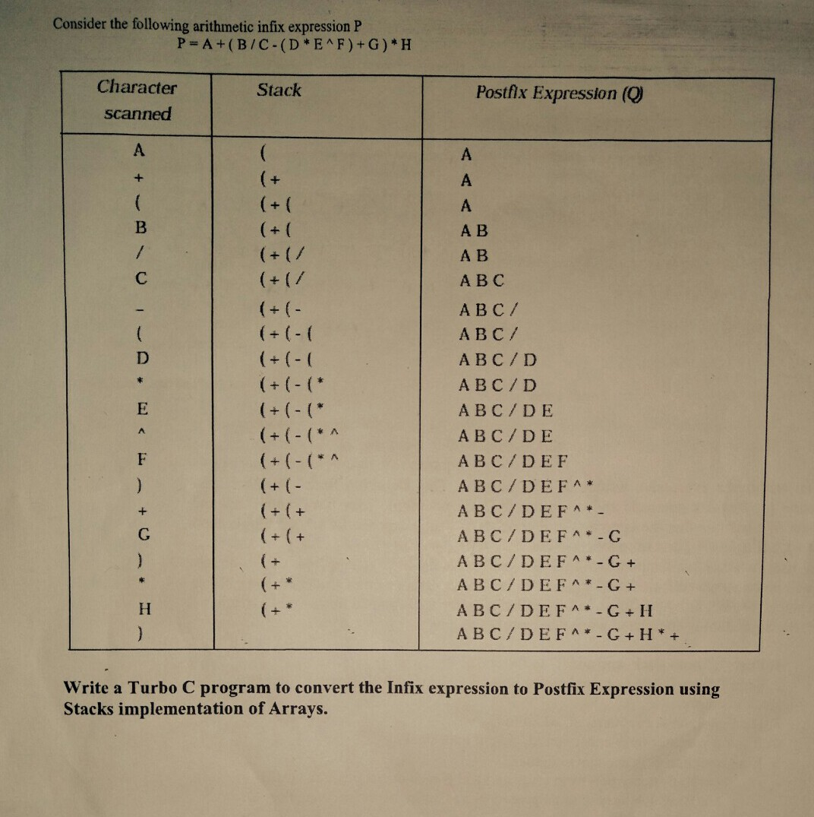

Slide 16
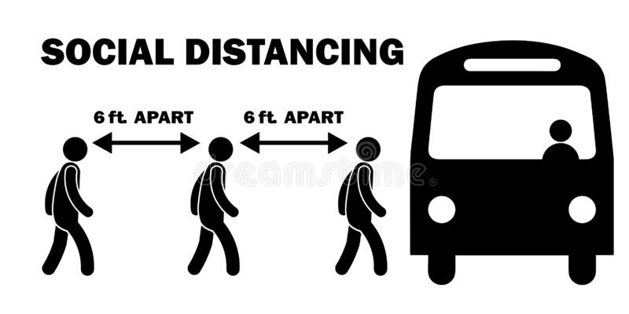

Slide 17
A queue is a linear list of elements in which deletions can take place only at one end, called the front, and insertions can take place only at the other end, called the rear.
The terms “front” and “rear” are used in describing a linear list only when it is implemented as a queue.
Queues are also called first-in first-out (FIFO) lists, since the first element in a queue will be the first element out of the queue.
This contrasts with stacks, which are last-in first-out (LIFO) lists.

Slide 18
Applications of Queue
There are various applications of queues discussed as below.
Queues are widely used as waiting lists for a single shared resource like printer, disk, CPU.
Queue are used to maintain the play list in media players in order to add and remove the songs from the play-list.
Queues are used in operating systems for handling interrupts.

Slide 19
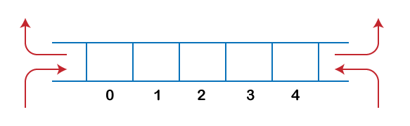

Slide 20
DEQUES
DEQUES A deque (pronounced either “deck” or “dequeue”) is a linear list in which elements can be added or removed at either end but not in the middle.
The term deque is a contraction of the name double-ended queue.
There are two variations of a deque—namely, an input-restricted deque and an output-restricted deque—which are intermediate between a deque and a queue.

Slide 21
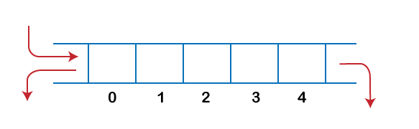
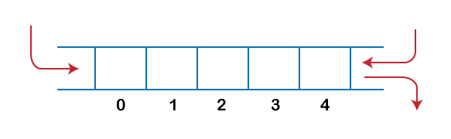
An input-restricted deque is a deque which allows insertions at only one end of the list but allows deletions at both ends of the list;
An output-restricted deque is a deque which allows deletions at only one end of the list but allows insertions at both ends of the list.

Slide 22
priority queue
A priority queue is a collection of elements such that each element has been assigned a priority and such that the order in which elements are deleted and processed comes from the following rules:
(1) An element of higher priority is processed before any element of lower priority.
(2) Two elements with the same priority are processed according to the order in which they were added to the queue.

